Slide 1




Scraping the Web for Data
An unsupervised method for gathering data
Notes:
You can use this slide as your opening or closing slide. Should you choose to use it as a closing, make sure you review the main points of your presentation. One creative way to do that is by adding animations to the various graphics on a slide. This slide has 4 different graphics, and, when you view the slideshow, you will see that you can click to reveal the next graphic. Similarly, as you review the main topics in your presentation, you may want each point to show up when you are addressing that topic.
Add animation to images and graphics:
Select your image or graphic.
Click on the Animations tab.
Choose from the options. The animation for this slide is “Split”. The drop-down menu in the Animation section gives even more animations you can use.
If you have multiple graphics or images, you will see a number appear next to it that notes the order of the animations.
Note: You will want to choose the animations carefully. You do not want to make your audience dizzy from your presentation.

Slide 2
Introduction
Machine Learning requires sizeable data
The internet is riddled with data, but it there’s not much structure
Makes it difficult to automate processes to mine data

Slide 3
Web scraping challenges
A lot….

Slide 4
Components
Spider
Two classes defined to scrape websites
Politico
Fox News
Text Agent
Encapsulates some basic NLP operations
TF-IDF word vectorization
Cosine Similarity
Appending to ontology

Slide 5
Procedure
Text Agent is initialized with the following
Text sample: should encompass a general topic the user wants
Similarity threshold
Spider carries a Text Agent through the target website
Spider scrapes articles from sites and passes them to the agent
Agent computes a similarity between initial sample and current text
If text is similar enough, append and continue
Else, stop expanding on child links

Slide 6
Goals
Demonstrate that any data is collectible
Gather relevant data with our current method
Find an adequate value for similarity
Demonstrate one potential use for this kind of text mining

Slide 7
Technique overview
Scrapy
Spider looks for articles in website based on rules
Latent Drichlet Allocation
Used to visualize concepts
Sentiment analysis
Provides a metric for sentiment in text
Sentiments are scored in their positive, negative, neutral and composite attributes
Lexical rule dictionary used for this study

Slide 8
Results – Items scrapped
Politico spider
Mueller articles: 117
2020 Election articles: 54
Fox News spider
Mueller articles: 168
2020 Election articles: 24

Slide 9
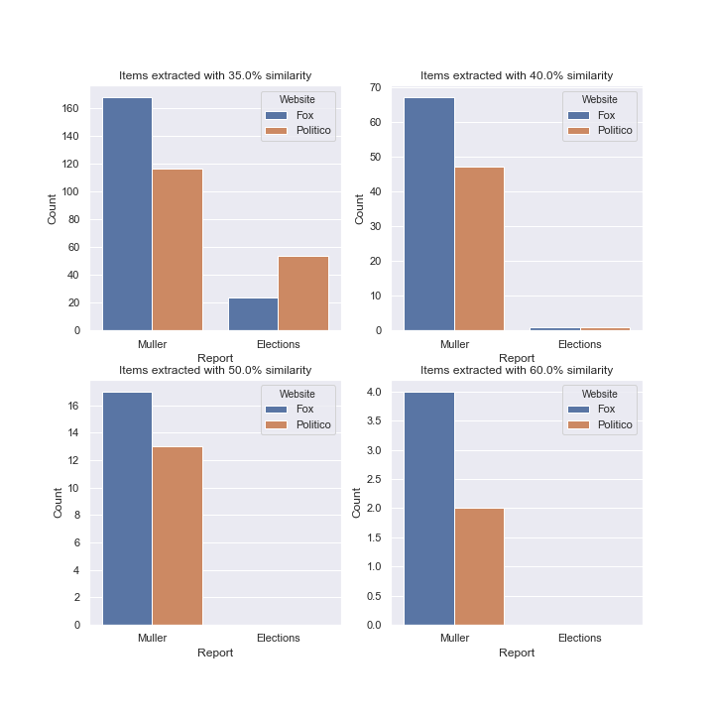
Results – Similarity Experiments

Slide 10
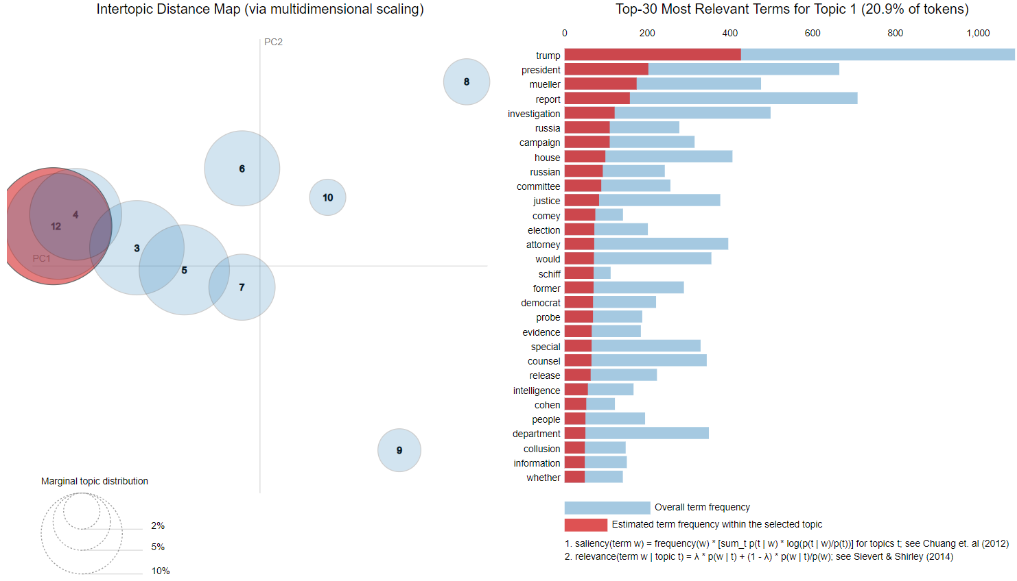
Results – LDA analysis (35% similarity)

Slide 11
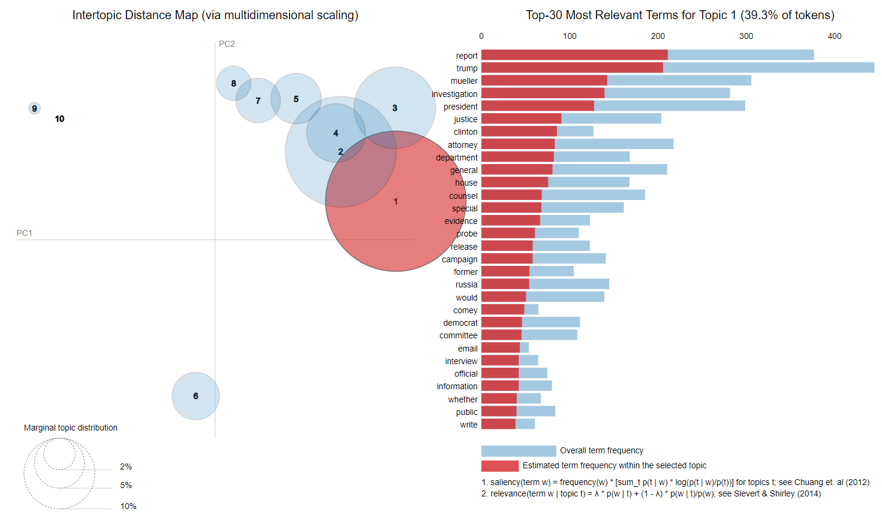
Results – LDA analysis (40% similarity)

Slide 12
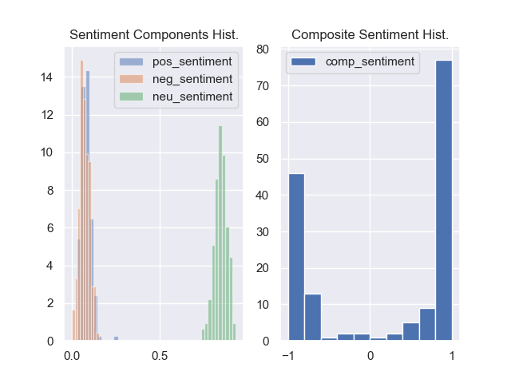
Results – Sentiment Analysis

Slide 13
Conclusions
All data is collectible
Our method provides a viable way to extract and sanitize data without supervision

